Slide 1
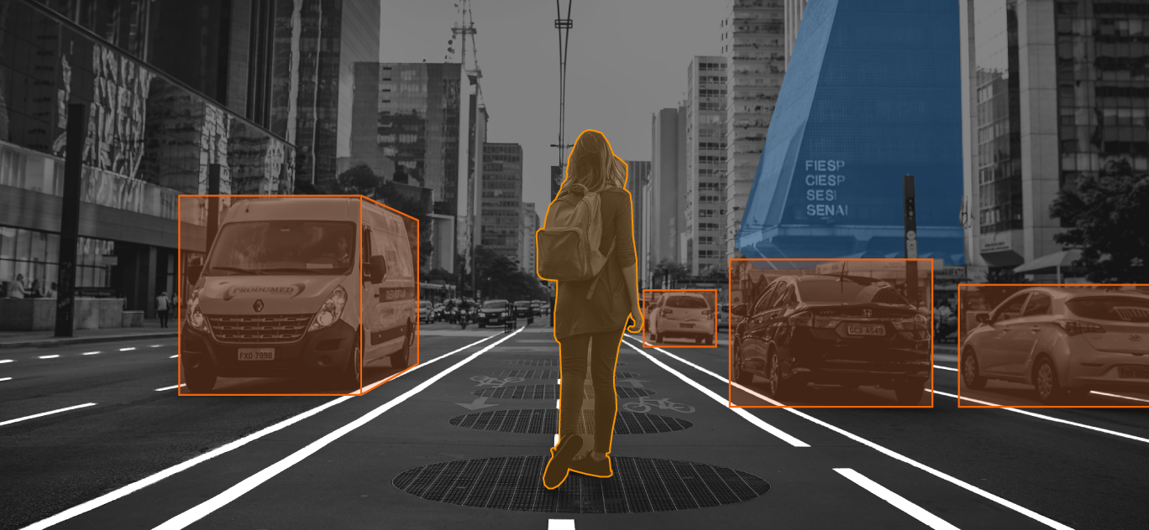
#1
Pengenalan Image Processing

Slide 2
Outline
Konsep dasar Computer Vision
Pengenal Tools, Library & Pemrograman pada Computer Vision
Install Anaconda 3 & Jupyter Lab
Membuat Environment di Anaconda
Membuat Project Baru di Jupyter Lab

Slide 3
Konsep dasar Image Processing
Computer vision is a field of artificial intelligence that trains computers to interpret and understand the visual world. Using digital images from cameras and videos and deep learning models, machines can accurately identify and classify objects — and then react to what they “see.”
(SAS)
Notes:
https://www.sas.com/en_us/insights/analytics/computer-vision.html

Slide 4
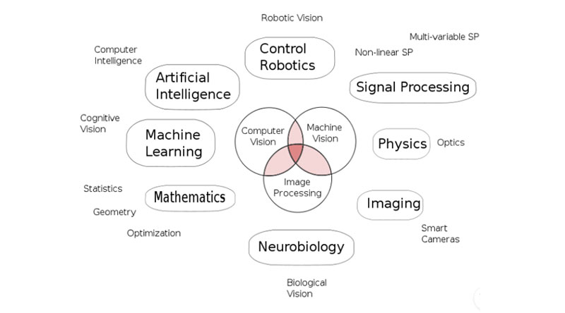
Konsep dasar Image Processing
Notes:
https://www.kdnuggets.com/2016/08/seven-steps-understanding-computer-vision.html

Slide 5
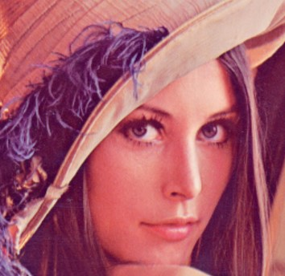
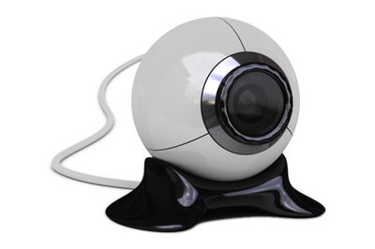
Konsep dasar Image Processing
Komputer
Object
Kamera
Software/Program
Notes:
https://www.sas.com/en_us/insights/analytics/computer-vision.html

Slide 6
Image as Digital Content
Image Preview
Image as matrix data
Notes:
https://www.sas.com/en_us/insights/analytics/computer-vision.html

Slide 7





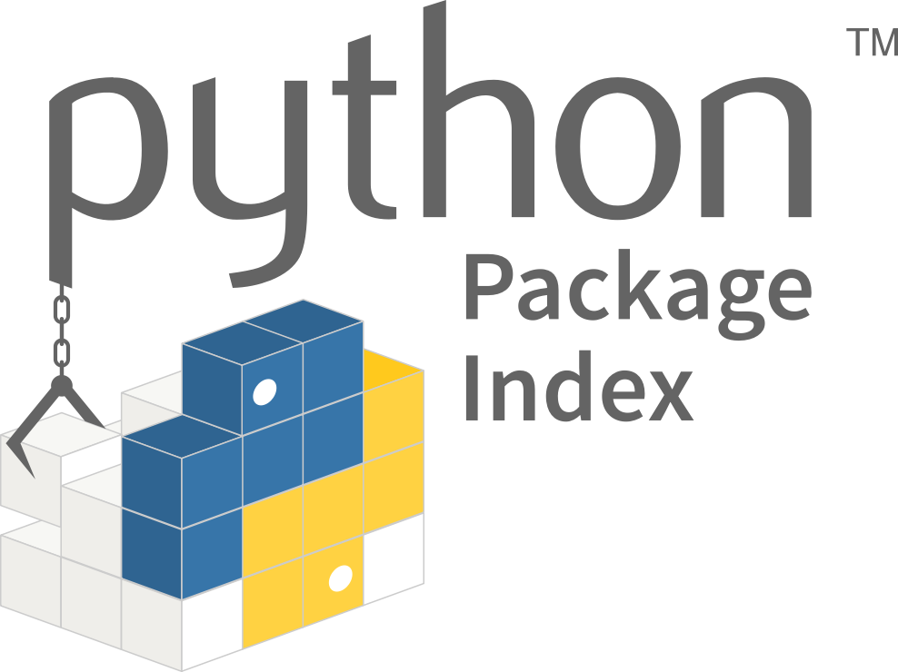



Pengenal Tools, Library & Pemrograman
Languange
Package
Development Tool
Library
Python
PIP
VS Code
Notes:
https://www.sas.com/en_us/insights/analytics/computer-vision.html

Slide 8
Pengenal Tools, Library & Pemrograman
Languange
Python is an interpreted, high-level and general-purpose programming language.
Created by Guido van Rossum and first released in 1991
Python

Slide 9
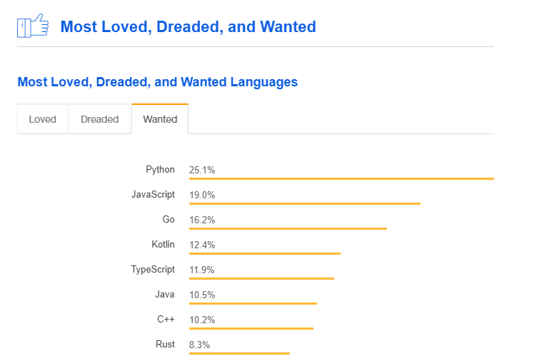
Pengenal Tools, Library & Pemrograman
Languange
Python
Notes:
https://insights.stackoverflow.com/survey/2018/#most-loved-dreaded-and-wanted

Slide 10

Pengenal Tools, Library & Pemrograman
Package
Notes:
https://www.anaconda.com/

Slide 11
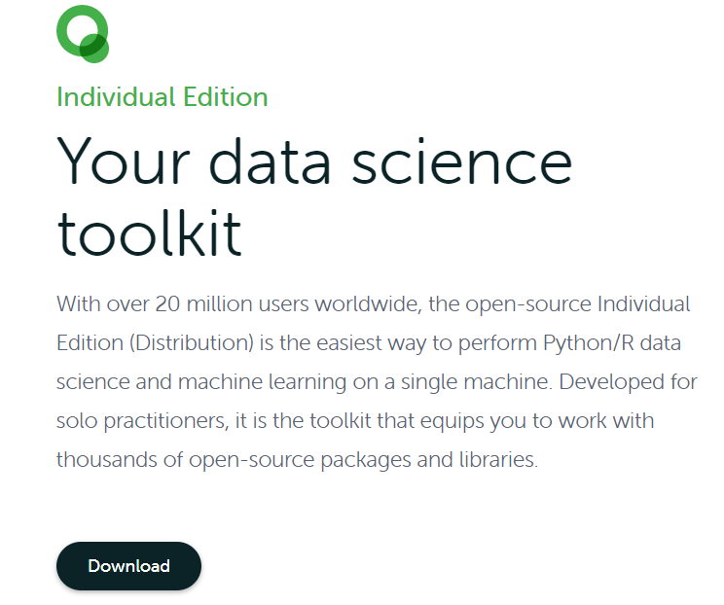
Pengenal Tools, Library & Pemrograman
Package
Notes:
https://www.anaconda.com/products/individual

Slide 12
Pengenal Tools, Library & Pemrograman
Package
Notes:
https://www.anaconda.com/products/individual

Slide 13
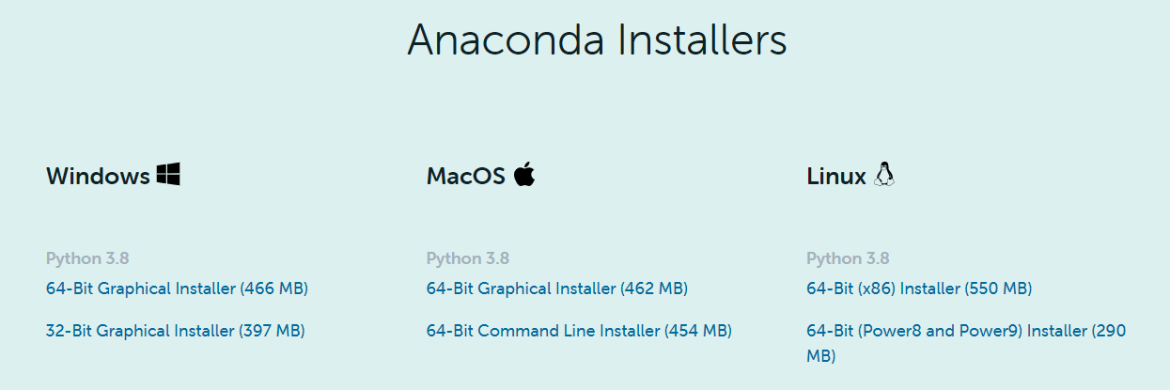
Pengenal Tools, Library & Pemrograman
Package
Notes:
https://www.anaconda.com/products/individual

Slide 14
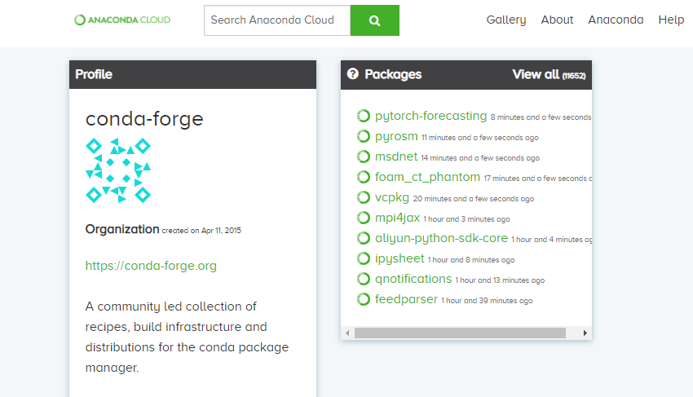
Pengenal Tools, Library & Pemrograman
Package
Conda Forge
Notes:
https://anaconda.org/conda-forge

Slide 15
Pengenal Tools, Library & Pemrograman
Package
Conda Forge
Notes:
https://anaconda.org/conda-forge

Slide 16
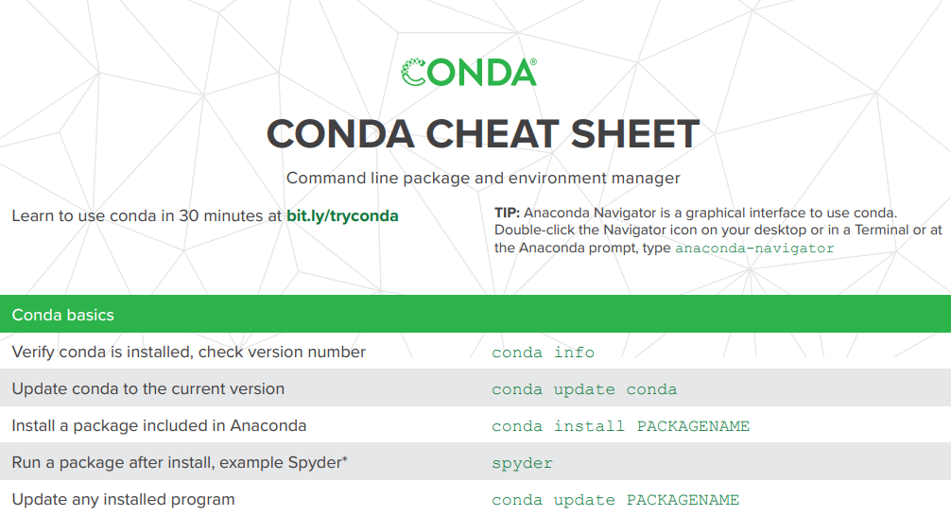
Pengenal Tools, Library & Pemrograman
Package
Conda Cheat Sheet
Notes:
https://anaconda.org/conda-forge

Slide 17
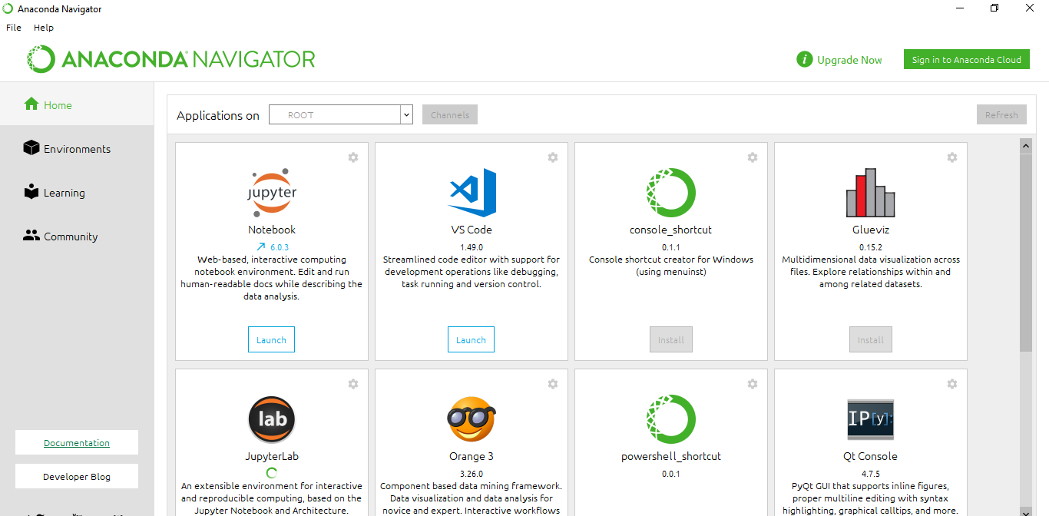
Pengenal Tools, Library & Pemrograman
Tool
Anaconda Navigator
Notes:
https://anaconda.org/conda-forge

Slide 18
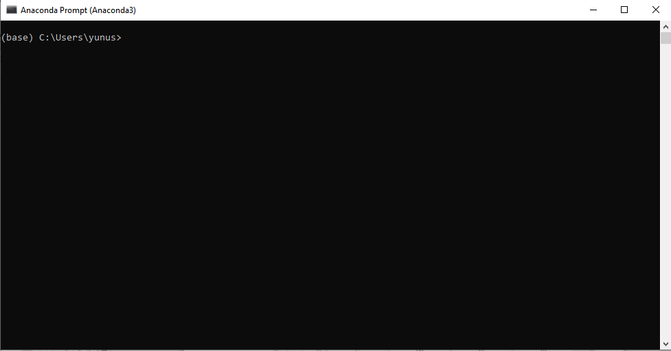
Pengenal Tools, Library & Pemrograman
Tool
Anaconda Prompt
Notes:
https://anaconda.org/conda-forge

Slide 19
Pengenal Tools, Library & Pemrograman
Tool
Anaconda Prompt
Notes:
https://anaconda.org/conda-forge

